Slide 1
Form I-589, Application for Asylum and Withholding of Removal
Information for Newly Arriving Migrant and Asylum Seekers
March 2024

Slide 2
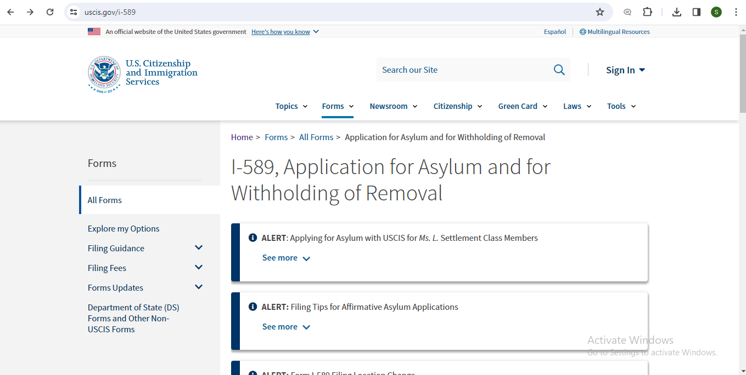

USCIS.gov/i589

Slide 3
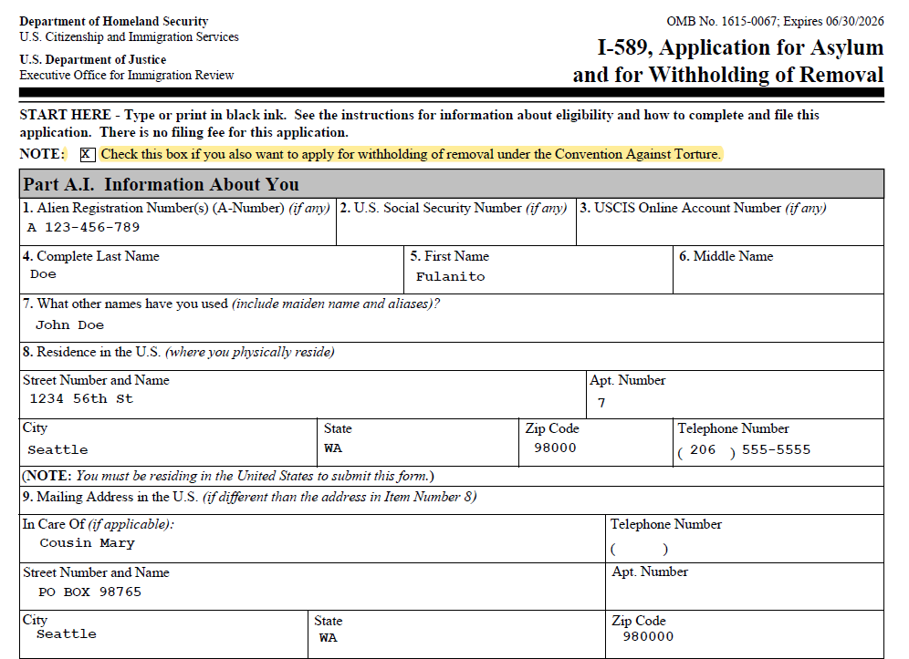
Page 1. Information about you

Slide 4
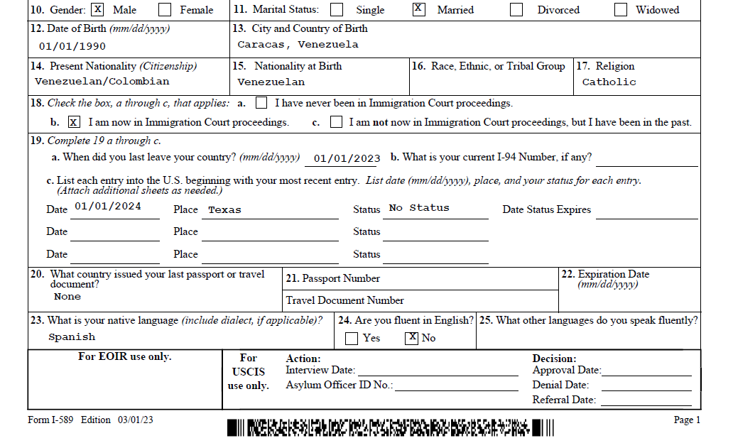
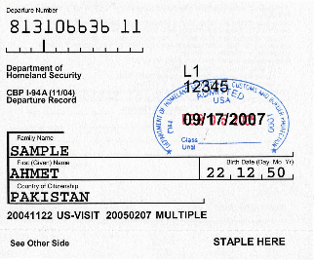
Page 1. Information about you

Slide 5
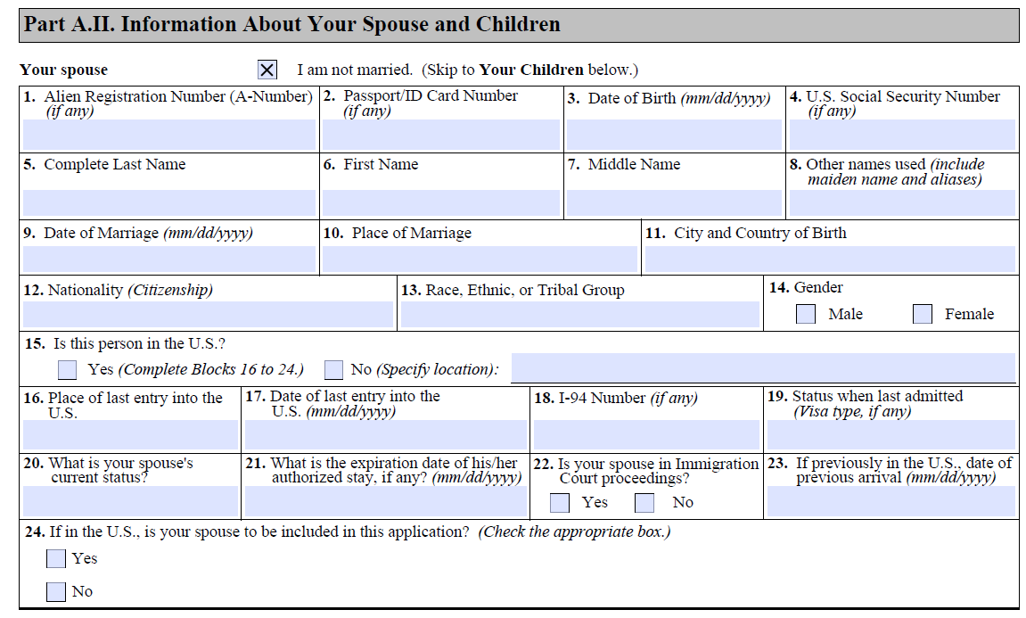
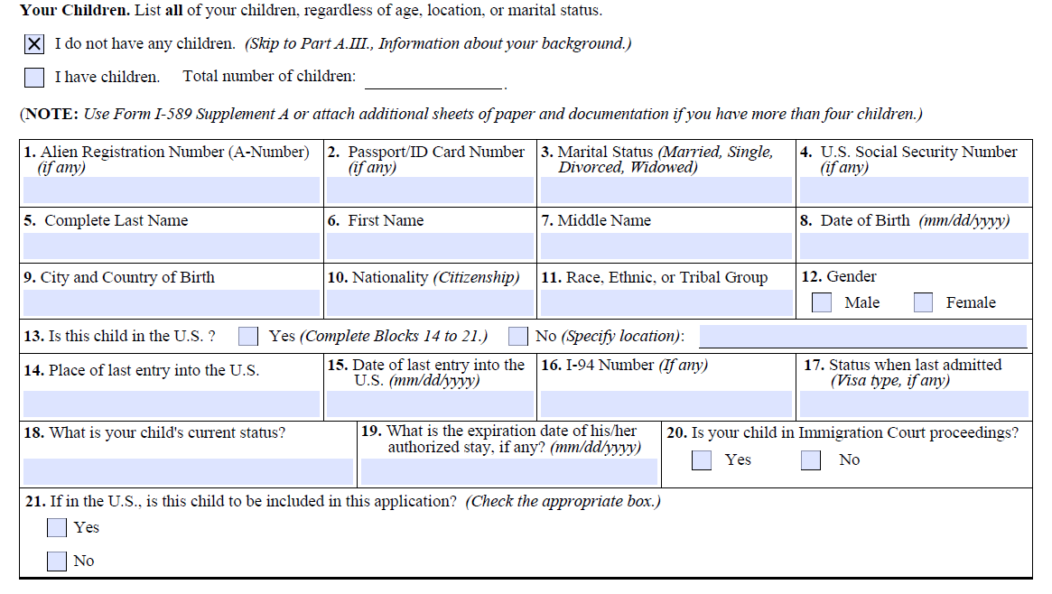
Page 2. Information about your family

Slide 6
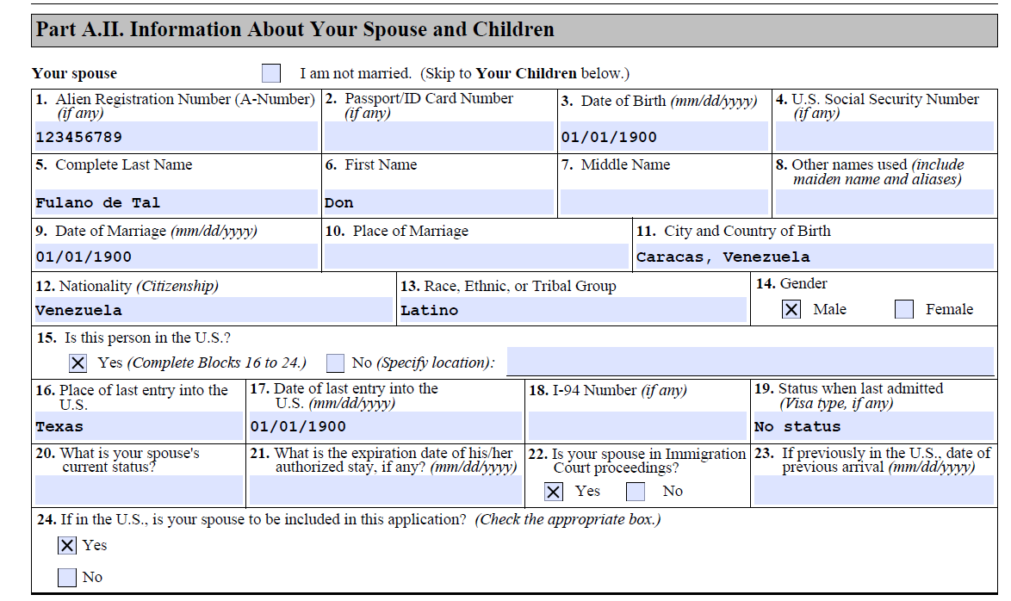
Page 2. Information about your family

Slide 7
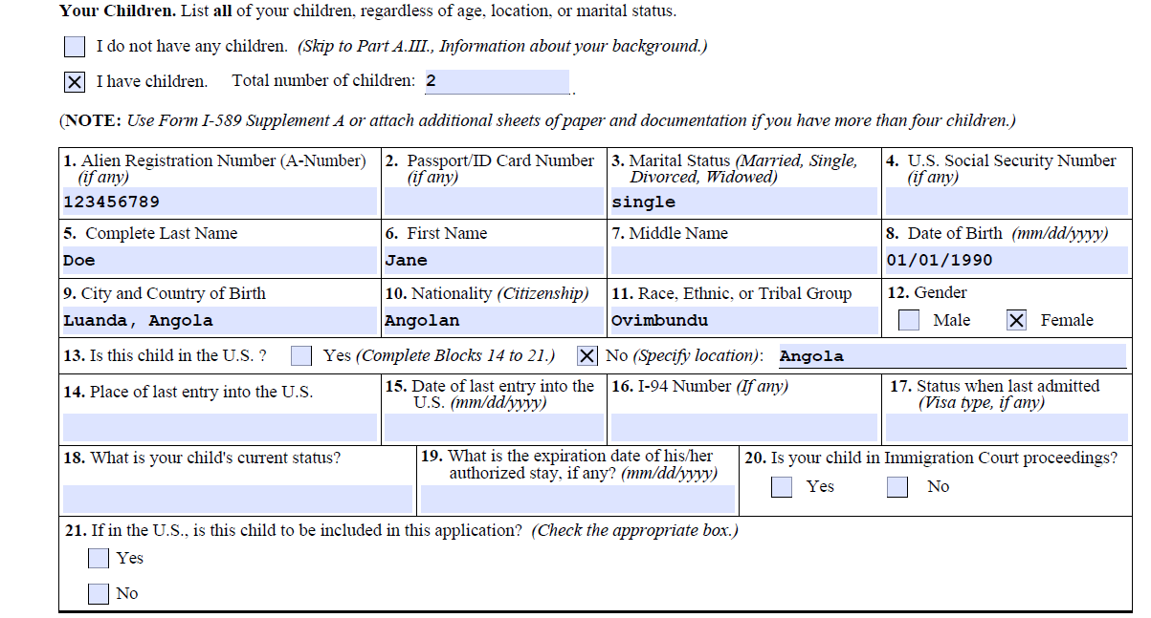
Pages 2-3. Information about your family

Slide 8
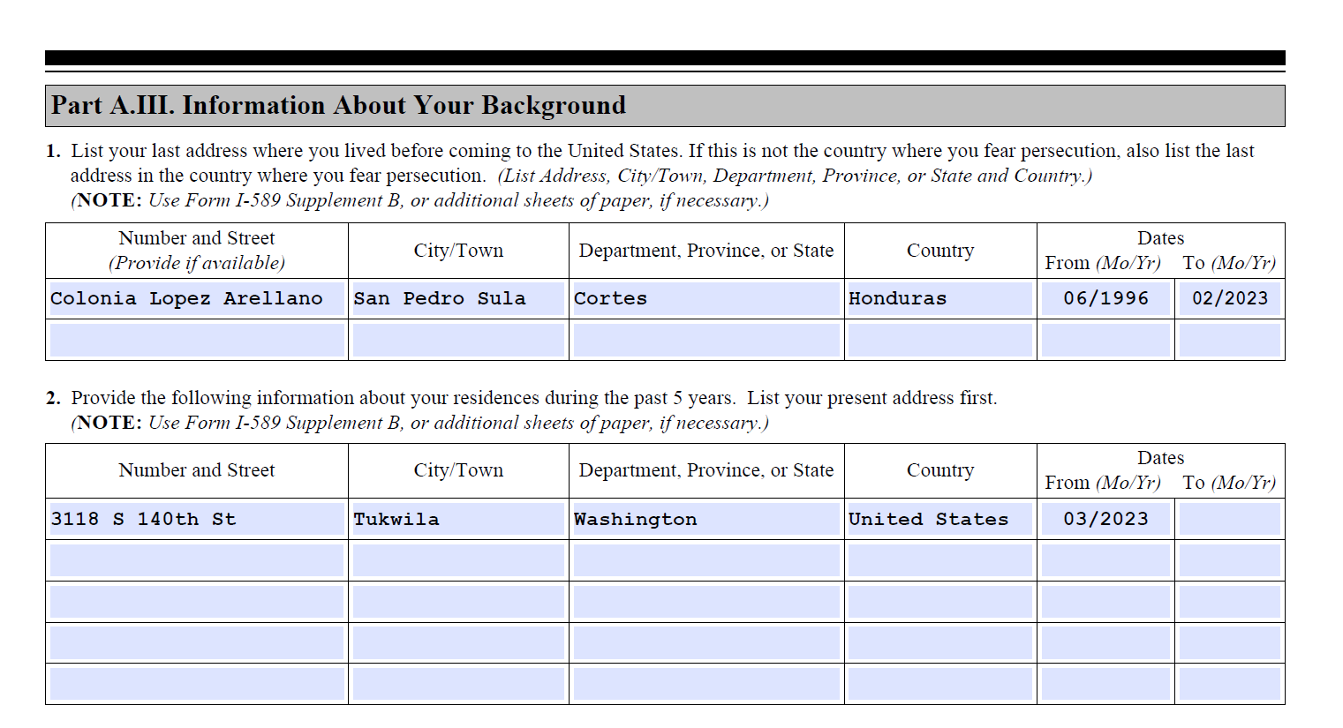
Page 4. Information about your background
Present

Slide 9
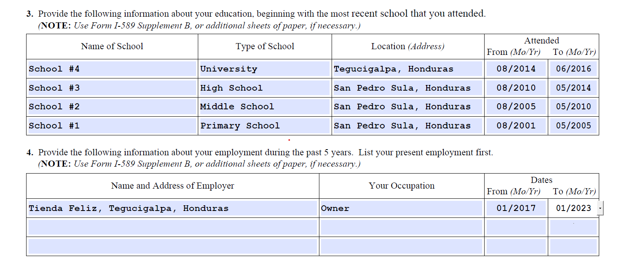
Page 4. Information about your background

Slide 10
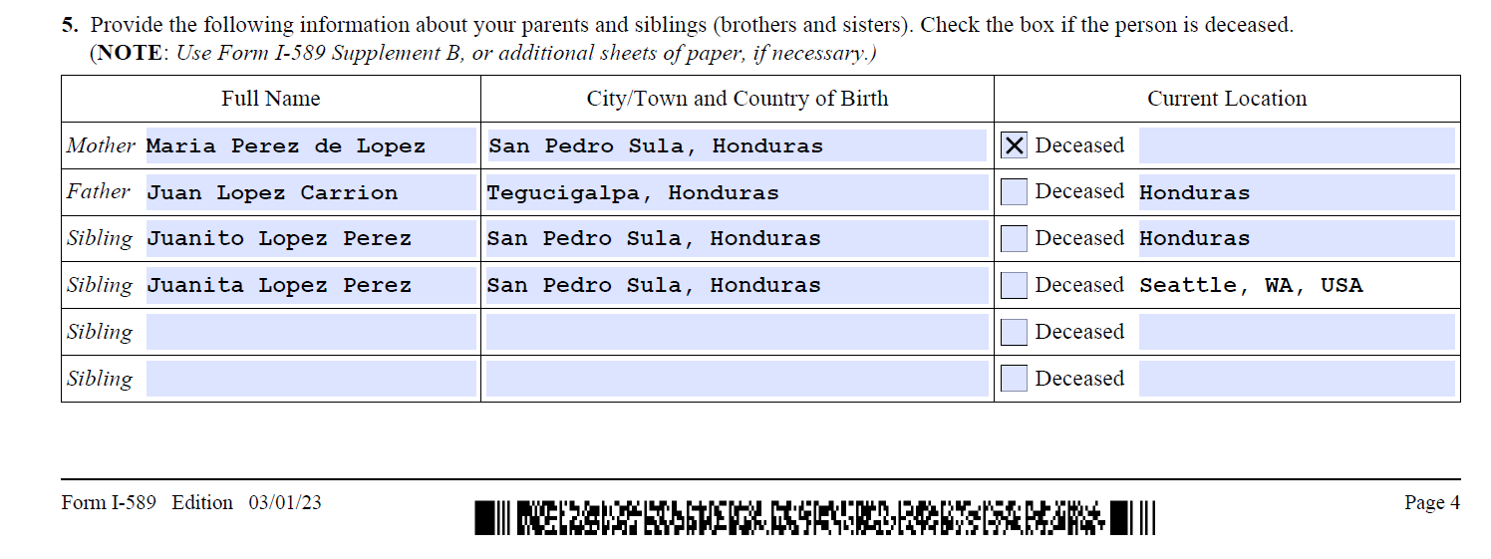
Page 4. Information about your background

Slide 11
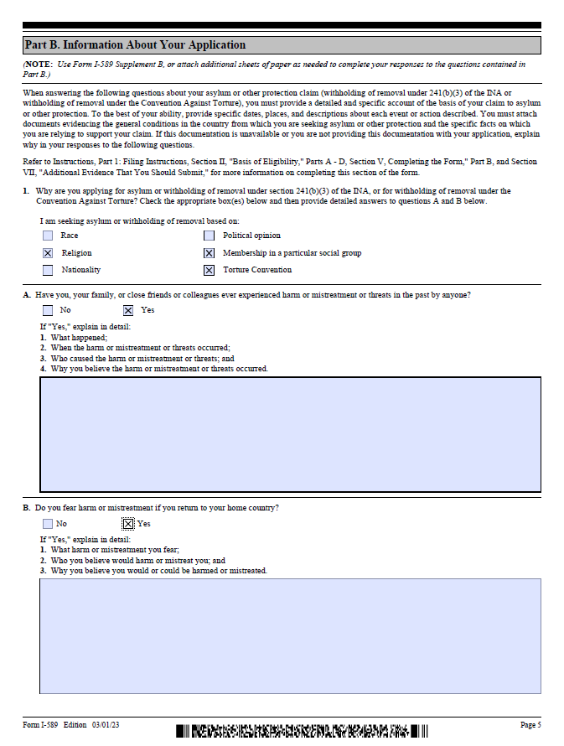
Page 5. Information about your application
Race Political Opinion
Religion Particular Social Group
Nationality
Torture Convention
What happened?
What, who, and why?

Slide 12
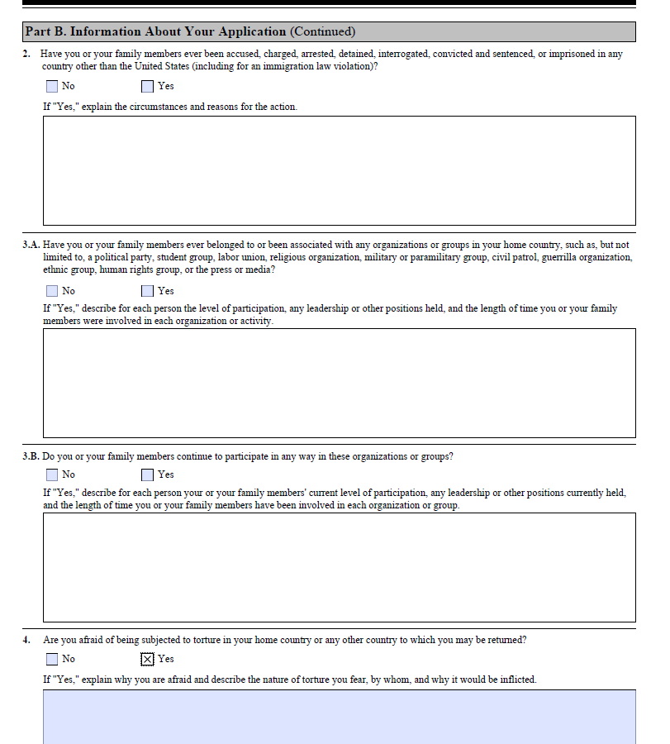
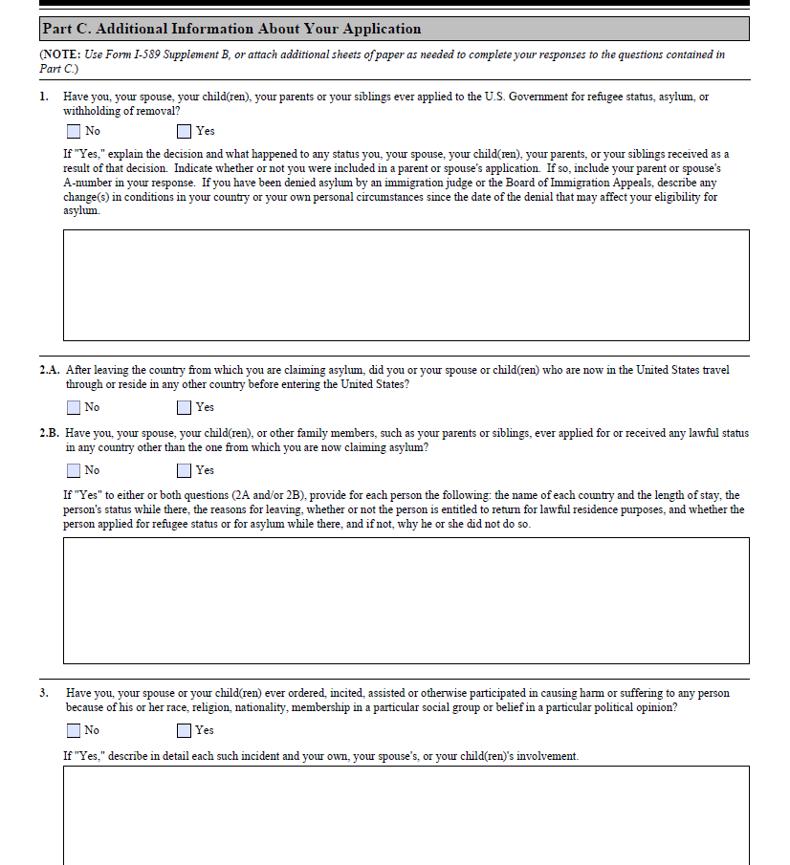
Pages 6-7. Information about your application

Slide 13
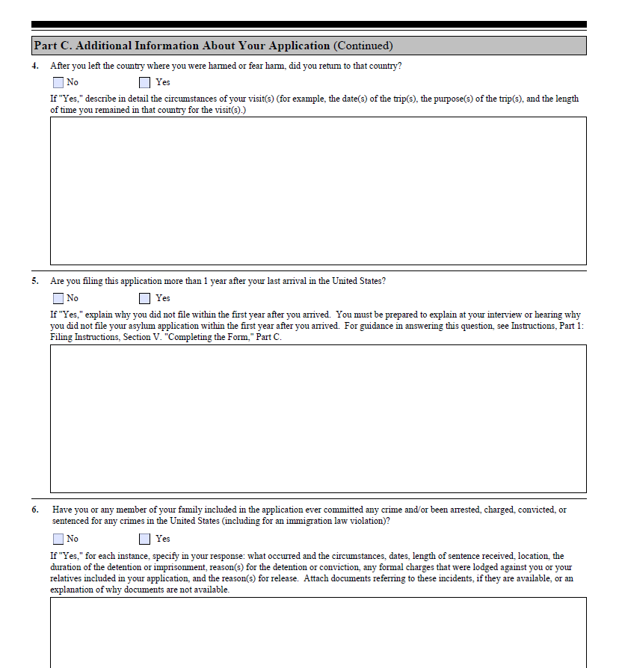
Page 8. Information about your application
Did you miss your one-year deadline?

Slide 14
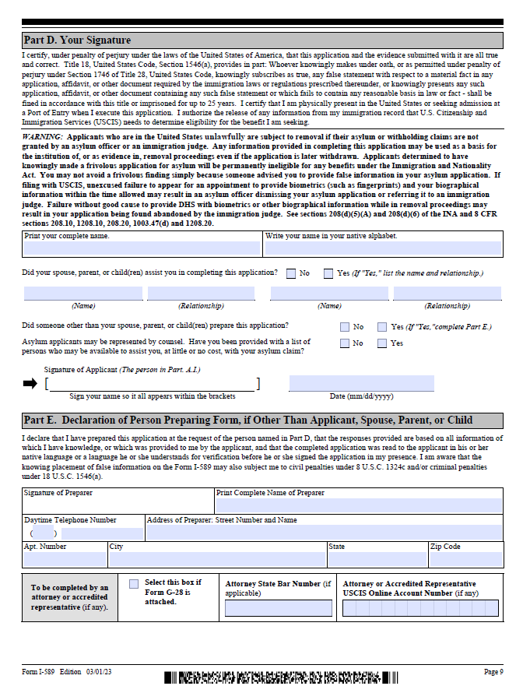

Page 9. Your signature
Write your name
AND

Slide 15
Documents to submit with your asylum application

Slide 16
File your asylum application

Slide 17
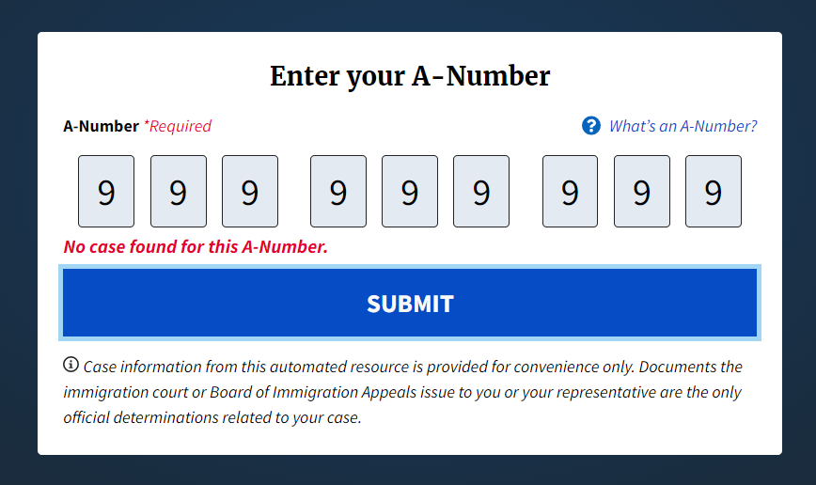
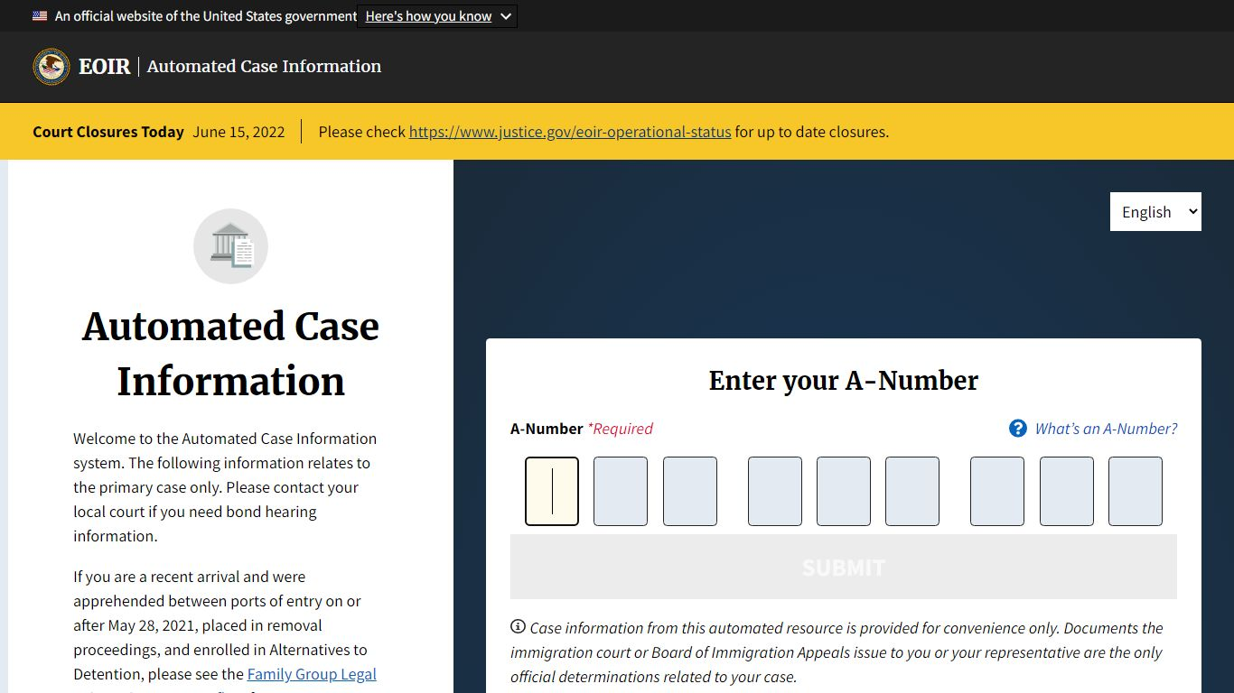
Filing with the Immigration Court

Slide 18
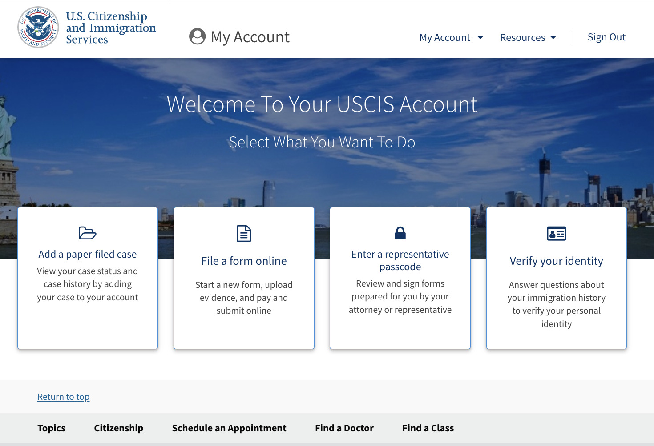

Filing with US Citizenship and Immigration Service (USCIS)

Slide 19
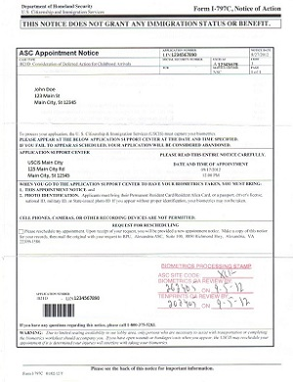

Biometrics Appointment

Slide 20
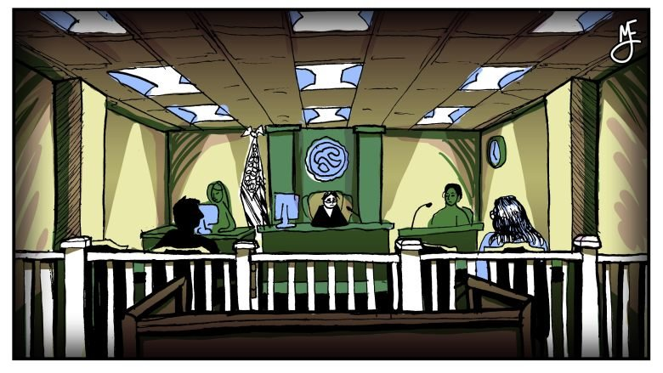

Asylum Interview and Immigration Court
Interview with a USCIS Asylum officer
A depiction of a typical immigration court hearing. Illustration by Michael Elizabeth Johnson.​

Slide 21
Asylum Benefits
Indefinite status​
Work authorization​
Access to certain public benefits and refugee assistance ​
Derivative status for spouse and unmarried children under 2 (petition within 2 years of asylum grant​)
Ability to travel with refugee travel document​
Adjustment of status (“green card”) after 1 year ​
Path to citizenship

Slide 22
For more immigration help please visit nwirp.org

